Slide 1
ME 233 Advanced Control II Lecture 3 Introduction to Probability Theory Random Vectors and Conditional Expectation
(ME233 Class Notes pp. PR4-PR6)
TexPoint fonts used in EMF.
Read the TexPoint manual before you delete this box.: AAAAA

Slide 2
Outline
Multiple random variables
Random vectors
Correlation and covariance
Gaussian random variables
PDFs of Gaussian random vectors
Conditional expectation of Gaussian random vectors

Slide 3
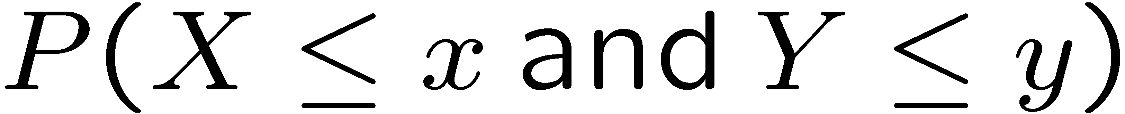
Multiple Random Variables
Let X and Y be continuous random variables.
Their joint cumulative distribution function (CDF) is given by

Slide 4
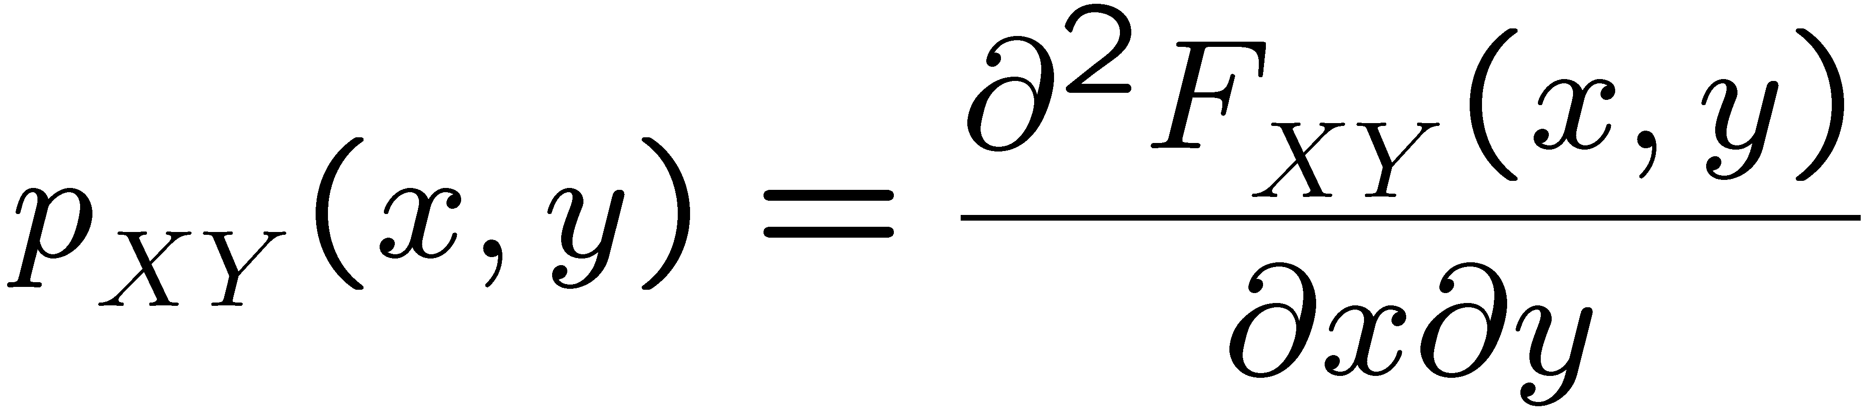
Multiple Random Variables
Let X and Y be continuous random variables with a differentiable joint CDF
Their joint probability density function (PDF) is

Slide 5
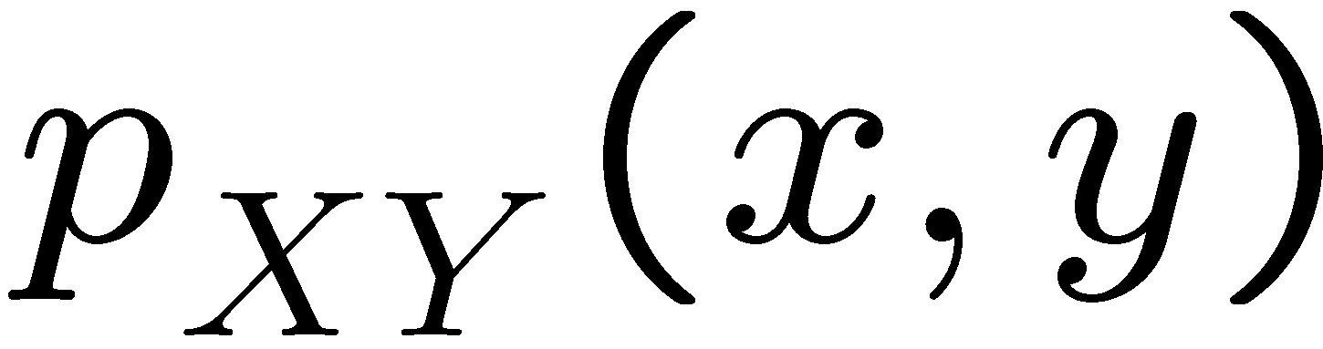
Multiple Random Variables
has the usual
meaning of density

Slide 6
Multiple Random Variables
Let X and Y be independent
Then:
Marginal CDF of X
Marginal CDF of Y

Slide 7
Multiple Random Variables
Let X and Y be independent
Then:
Marginal PDF of X
Marginal PDF of Y

Slide 8
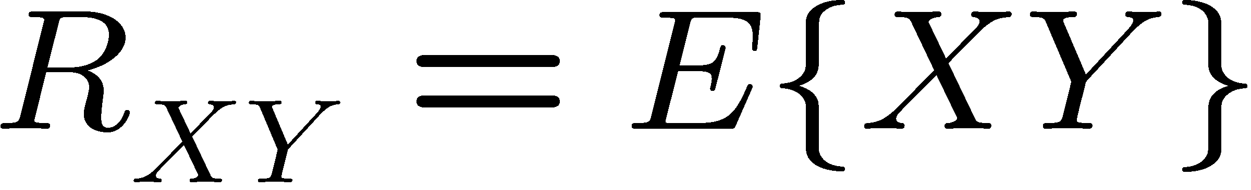
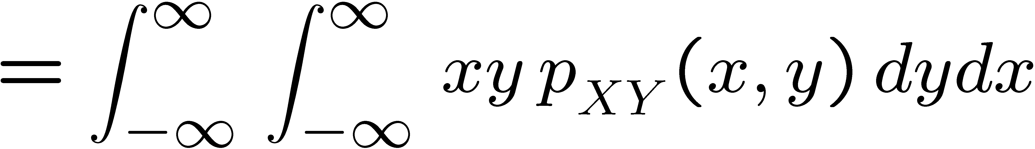
Correlation and Covariance
Let X and Y be continuous random variables with joint PDF
Correlation:

Slide 9
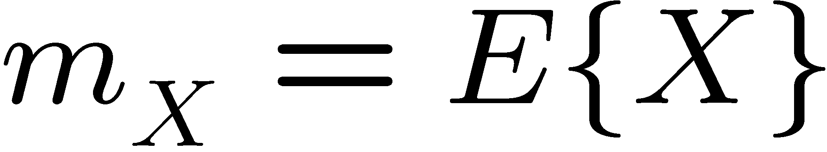
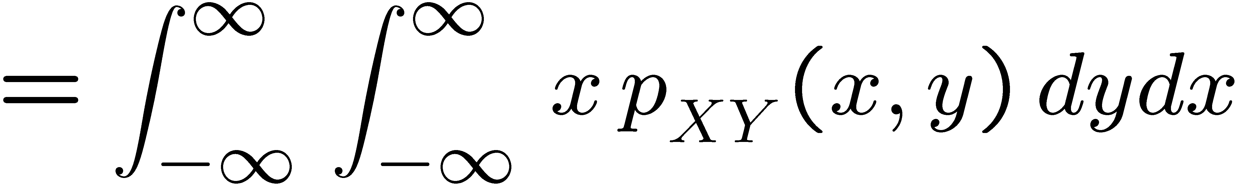
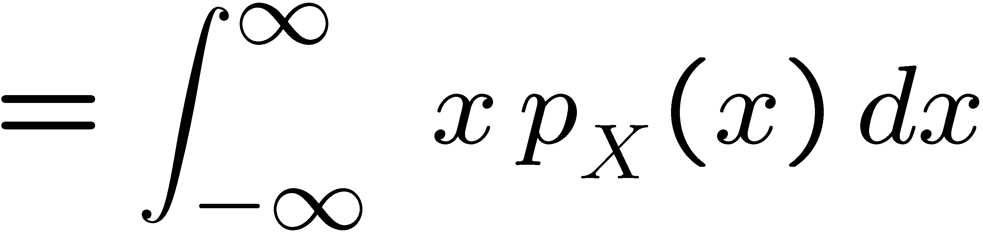
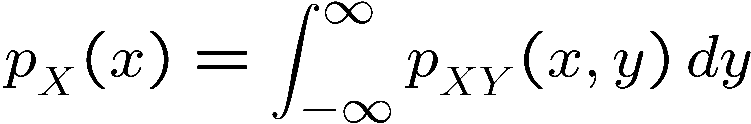
Mean
Let X and Y be continuous random variables with joint PDF
Mean:
where

Slide 10
Correlation and Covariance
Let X and Y be continuous random variables with joint PDF
Covariance:
means

Slide 11
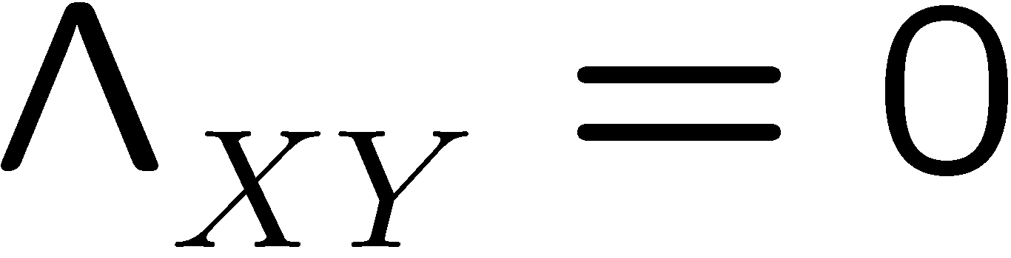

Correlation and Covariance
Let X and Y be continuous random variables with joint PDF
X and Y are uncorrelated if :
their covariance is zero
X and Y are orthogonal if :
their correlation is zero

Slide 12



Multiple Random Variables
X and Y are uncorrelated if and only if
Proof:
therefore

Slide 13
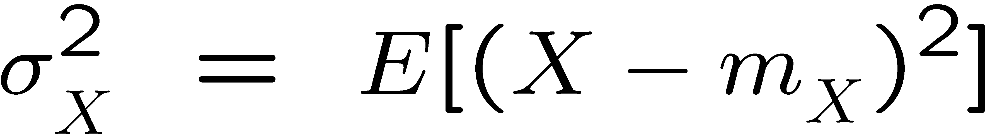

Variance
The variance of random variable X is:

Slide 14

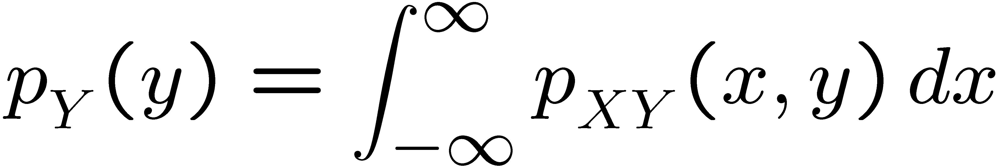
Marginal PDF
Let X and Y have a joint PDF
Marginal or unconditional PDFs:

Slide 15

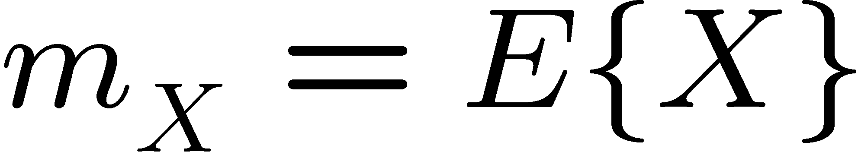
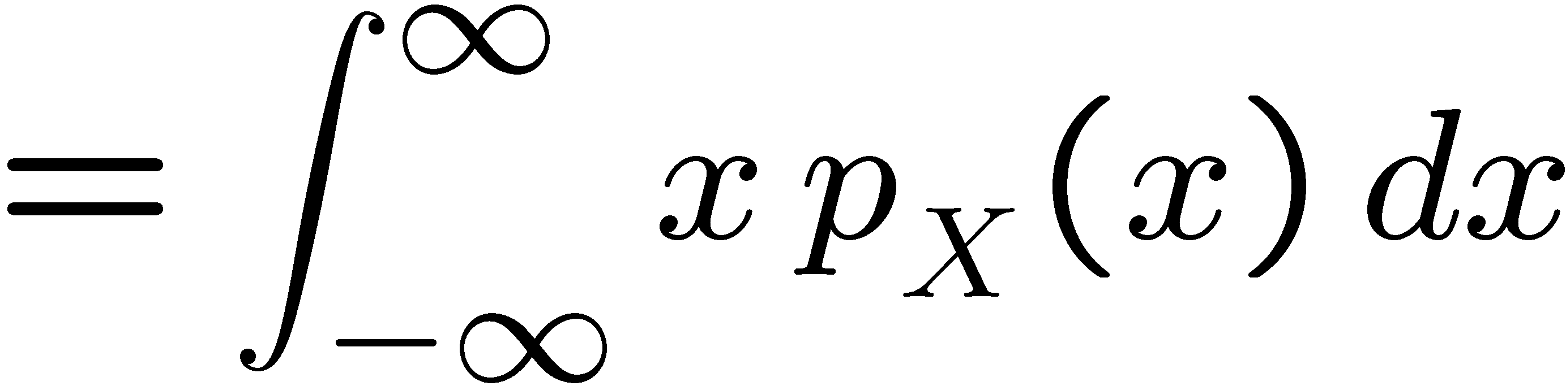
Marginal PDF
Let X and Y have a joint PDF
Expected value of X

Slide 16
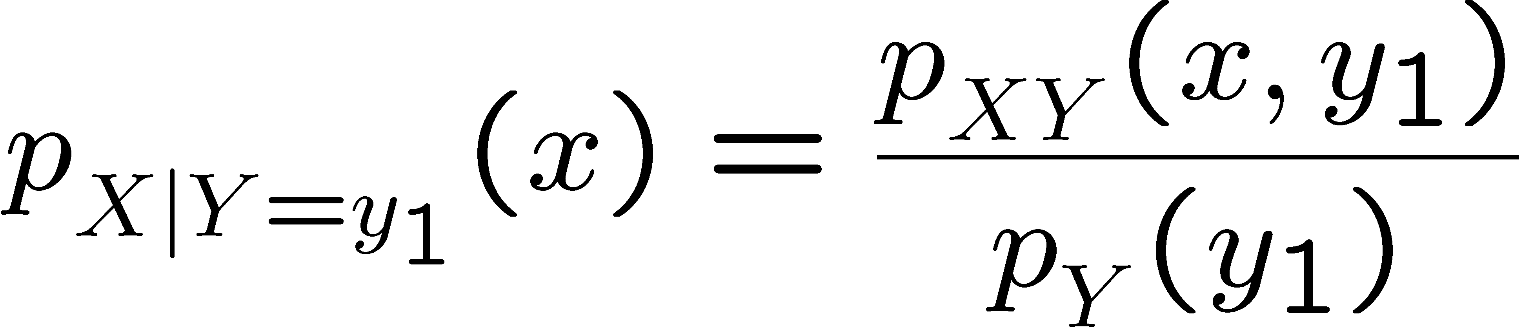
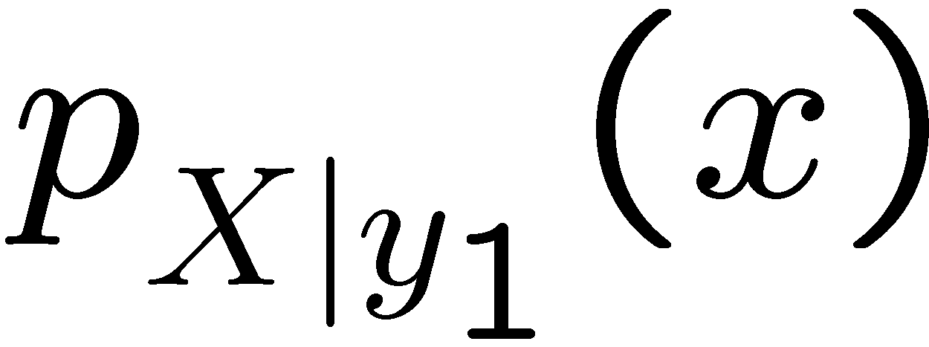
Conditional PDF
Let X and Y have a joint PDF
The Conditional PDF of X given an outcome of Y = y₁ :

Slide 17
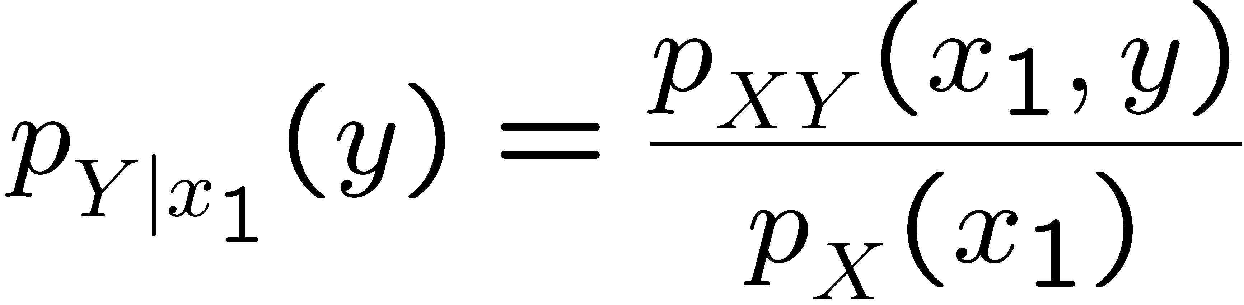
Conditional PDF
Let X and Y have a joint PDF
The Conditional PDF of Y given an outcome of X = x₁ :

Slide 18
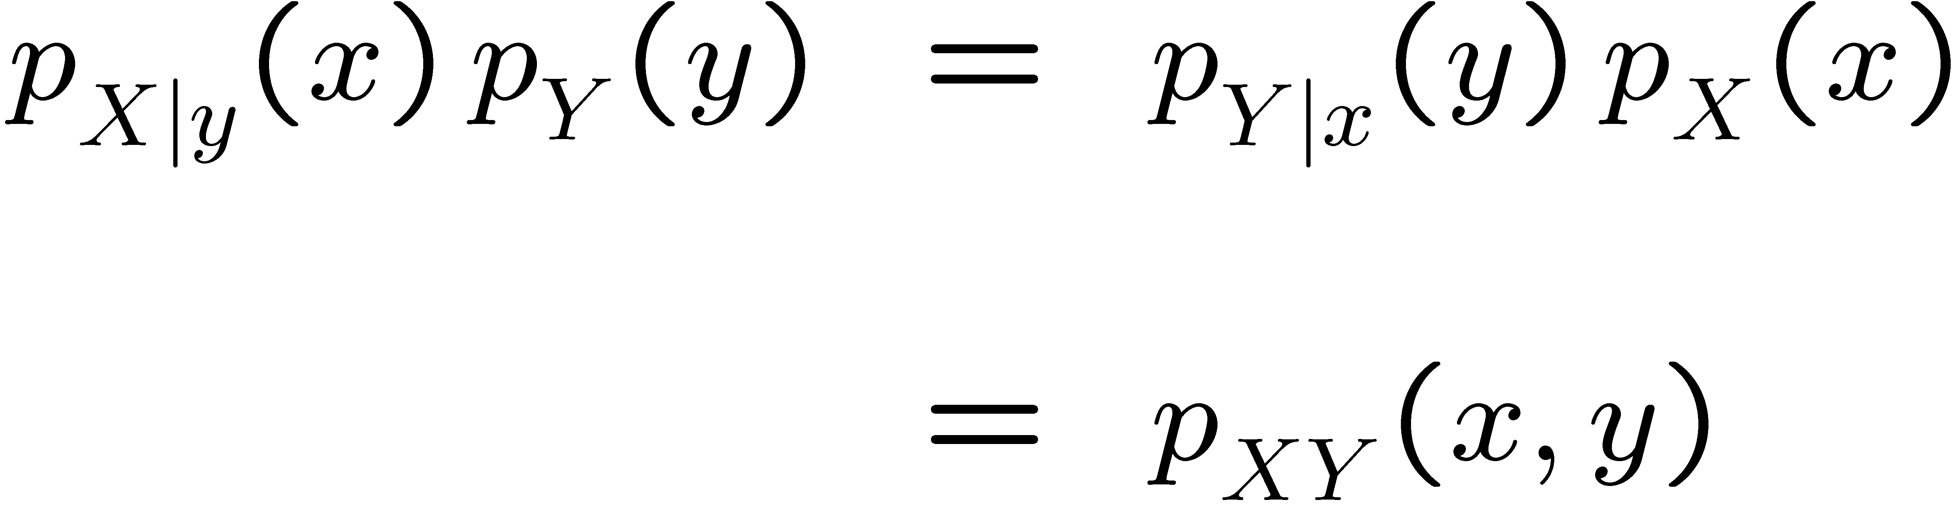
Conditional PDF
Let X and Y have a joint PDF
Bayes’ rule:

Slide 19
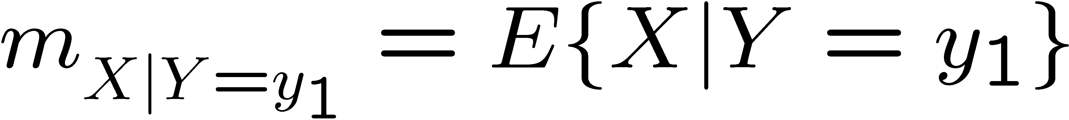
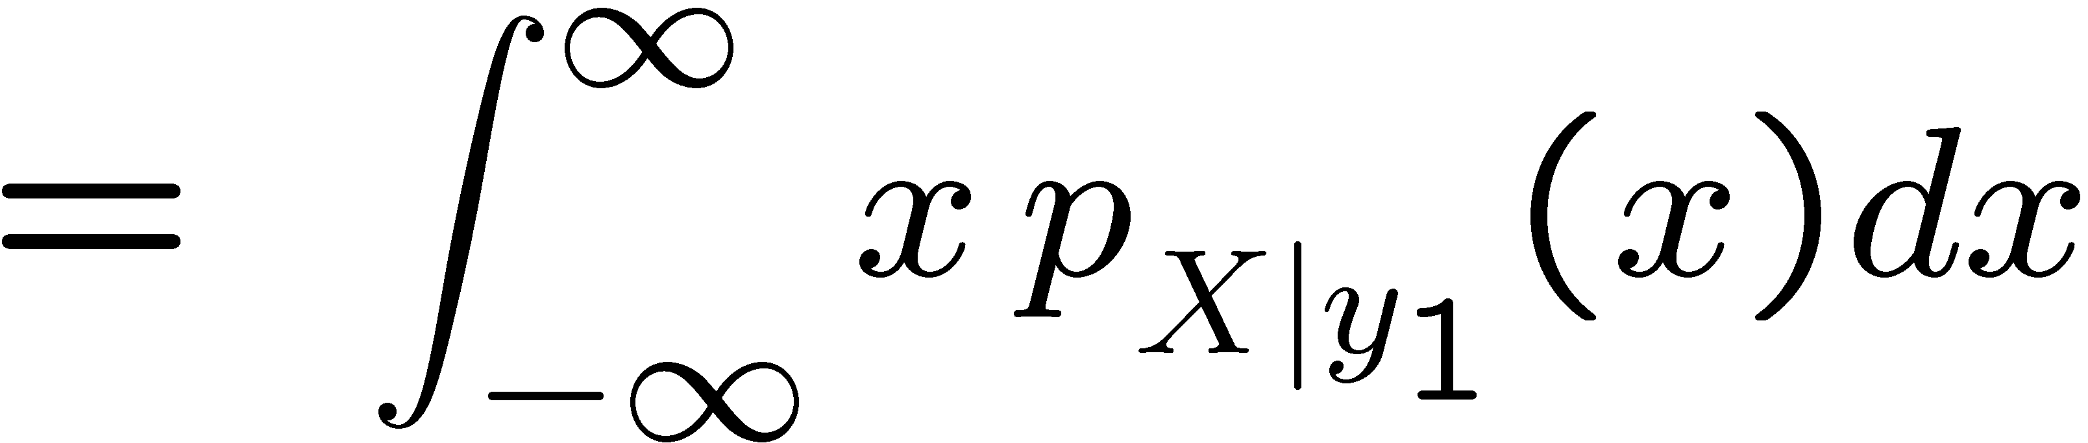

Conditional Expectation
Let X and Y have a joint PDF
Conditional Expectation of X given an outcome of Y = y₁ :

Slide 20
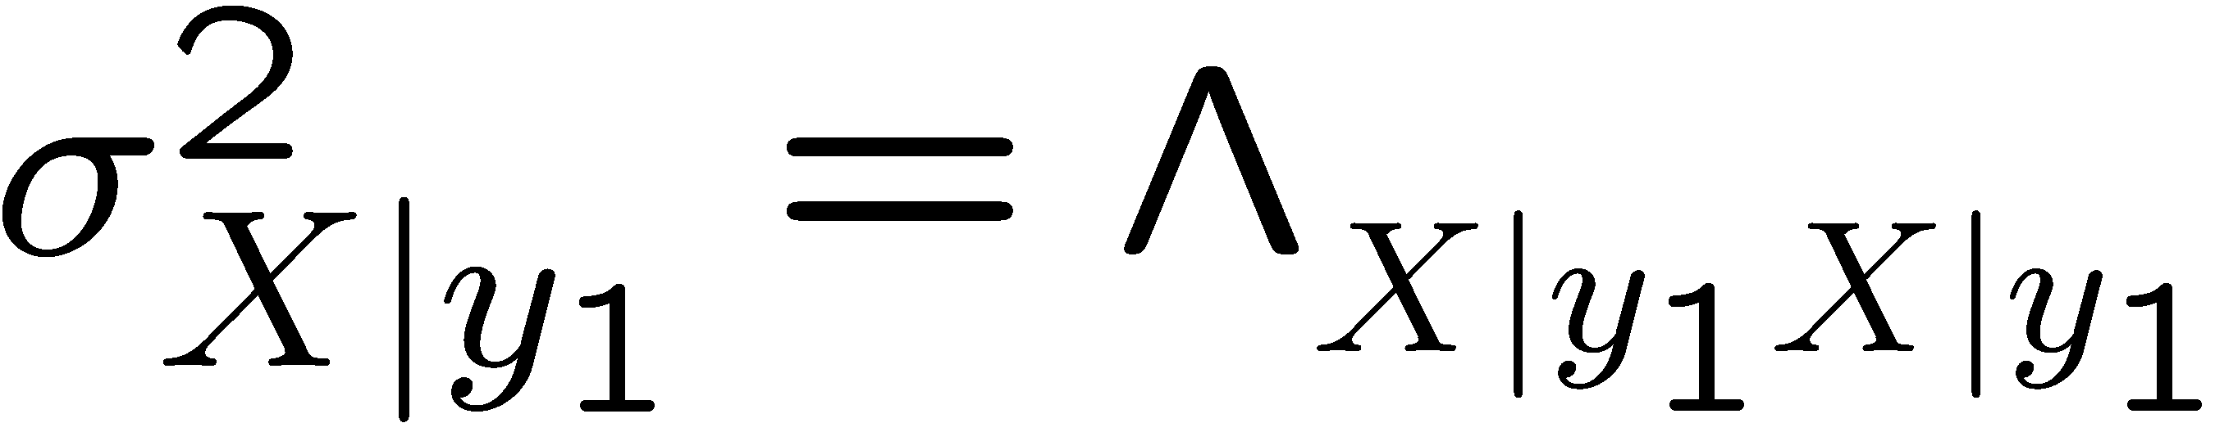
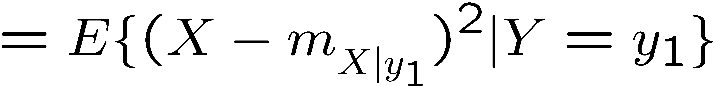
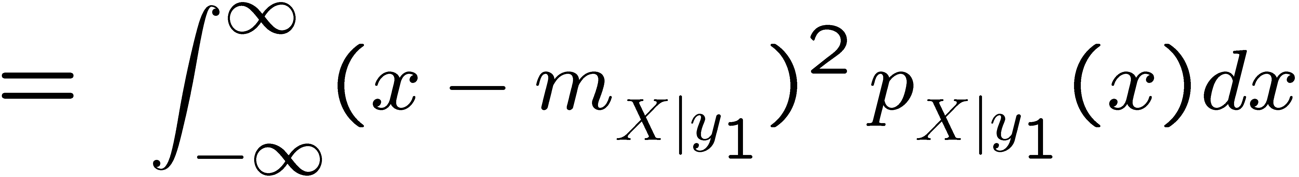
Conditional Variance
Let X and Y have a joint PDF
Conditional variance of X given an outcome of Y = y₁ :

Slide 21
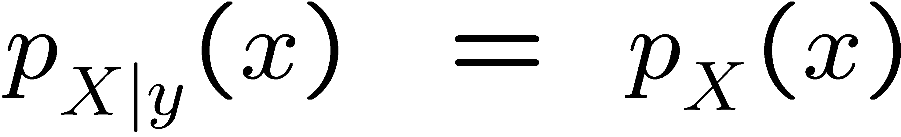
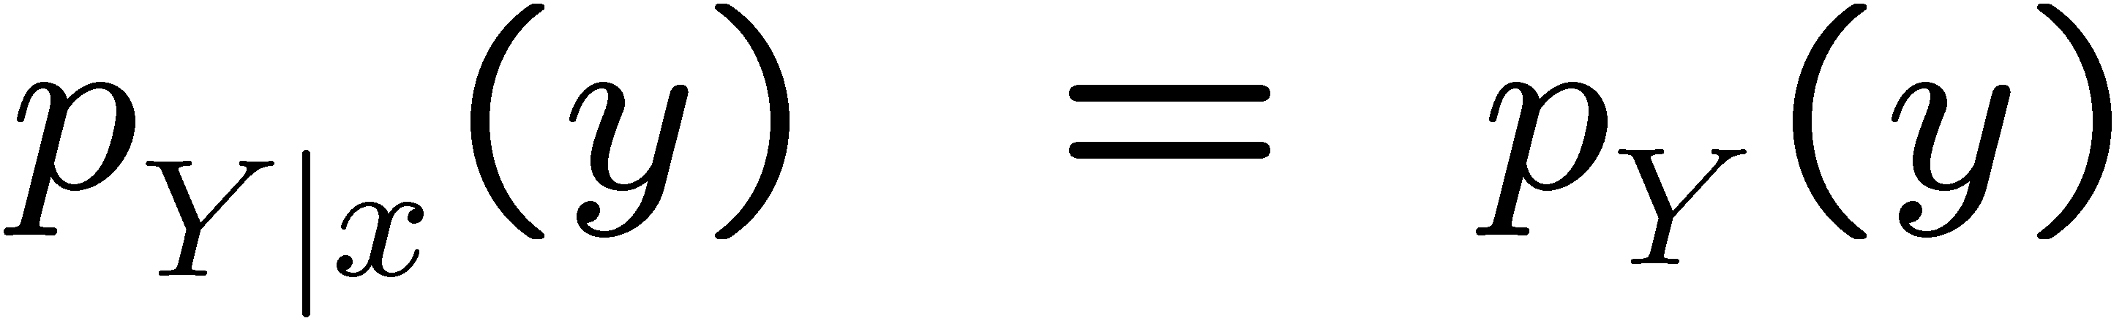
Independent Variables
Let X and Y be independent. Then:

Slide 22

Independent Variables
If X and Y are independent random variables, then X and Y are uncorrelated
Proof:
(independence)
The converse statement is NOT true in general

Slide 23


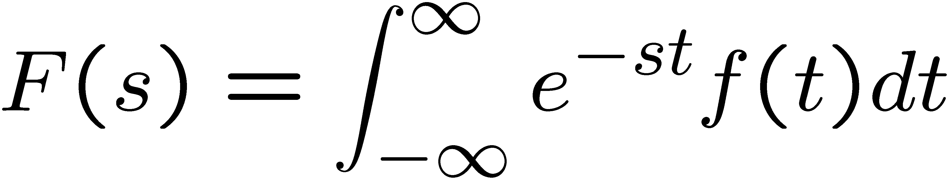

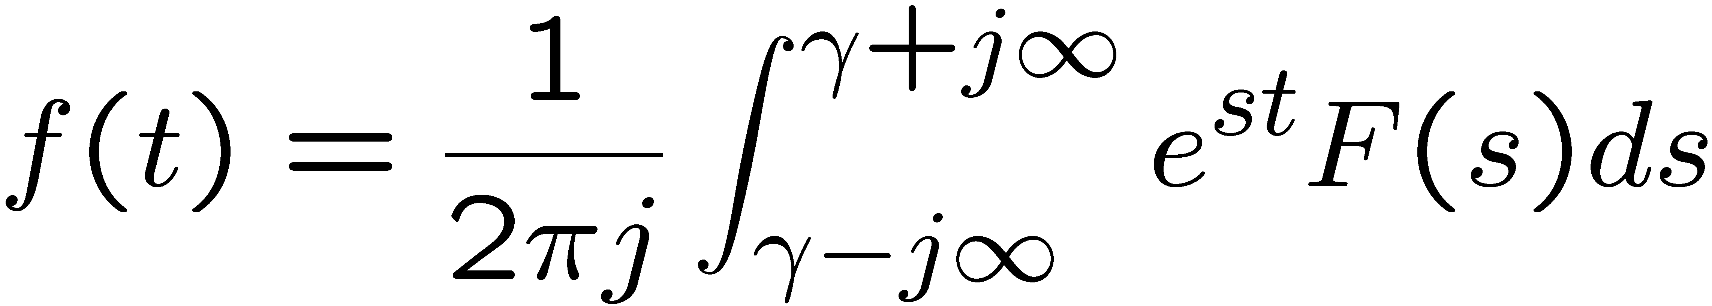
Bilateral Laplace and Fourier Transforms
Given
Laplace transform:
Inverse Laplace transform:
for some real γ so that contour path of integration
is in the region of convergence

Slide 24

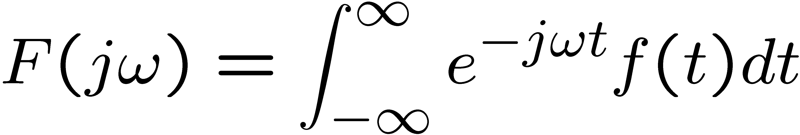

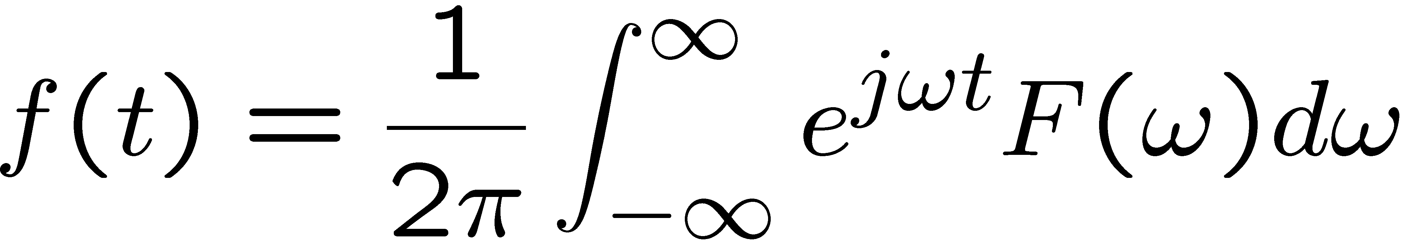
Bilateral Laplace and Fourier Transforms
Given
Fourier transform:
Inverse Fourier transform:

Slide 25
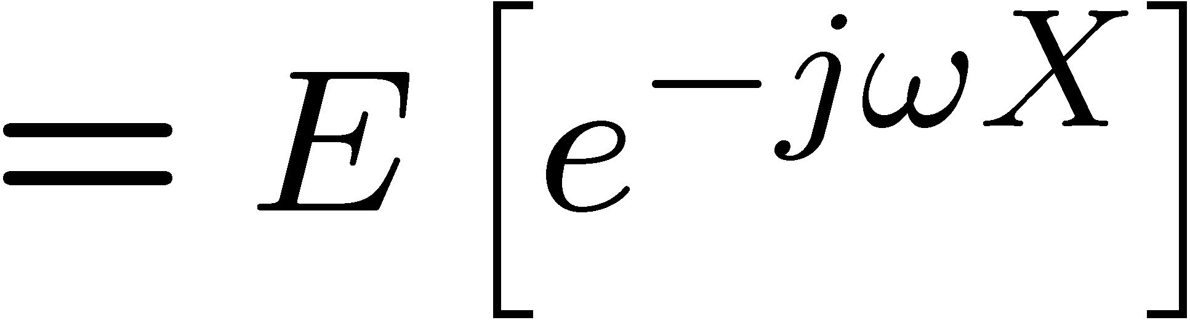
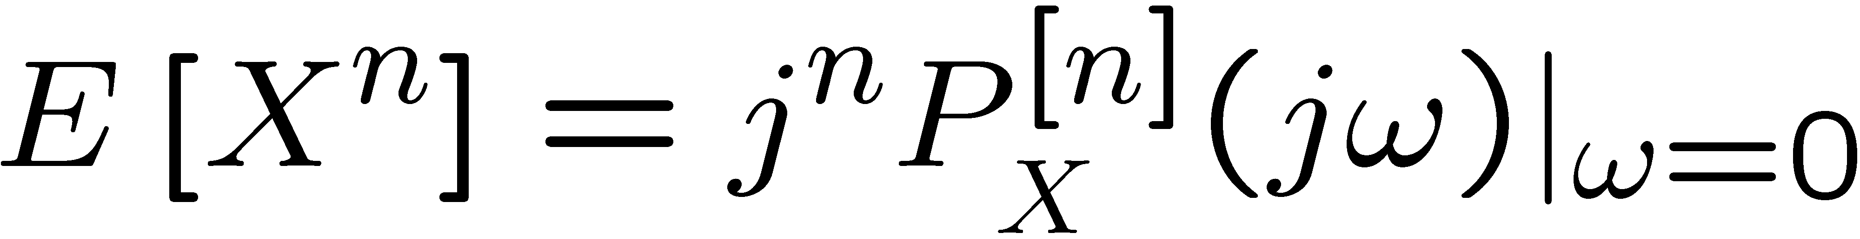
Moment Generating Function
The Fourier transform of the PDF of a random variable X is also called the moment generating function or characteristic function
Notice that, given the PDF p_{X}(x)
it can be shown that
where ^{[n]} indicates the nth derivative w/r ω (see Poolla’s notes)

Slide 26

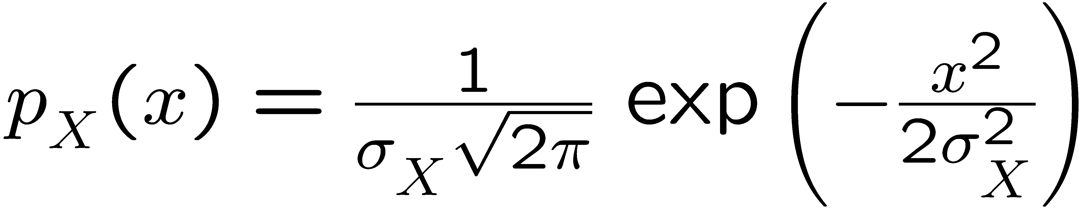


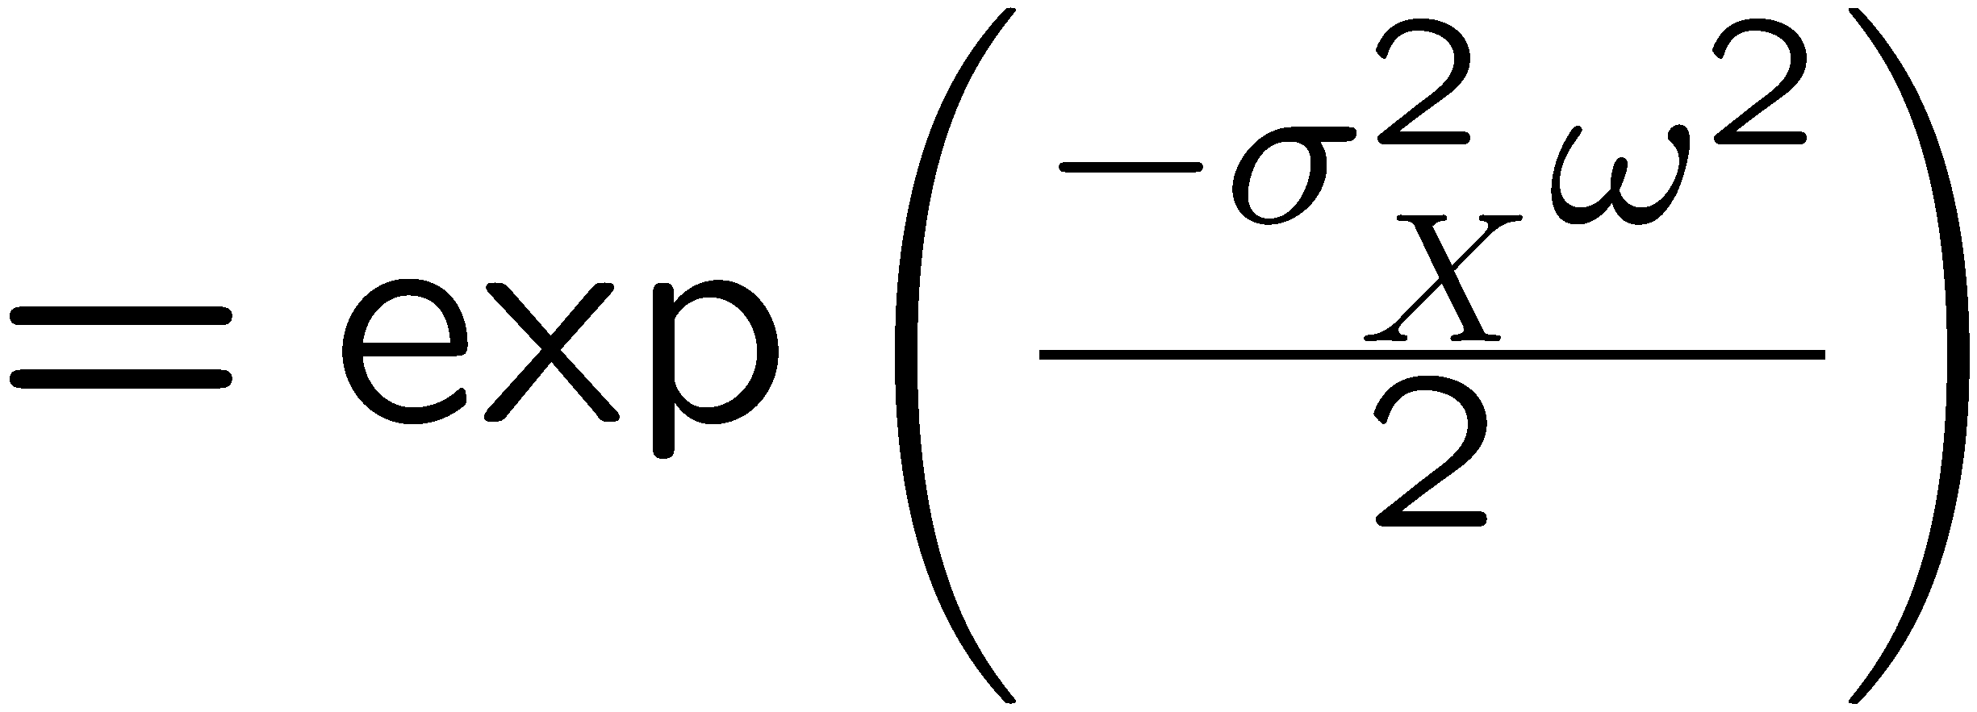
Properties of Normal distributions
The moment generating function of a zero-mean normal distribution is also normal.

Slide 27

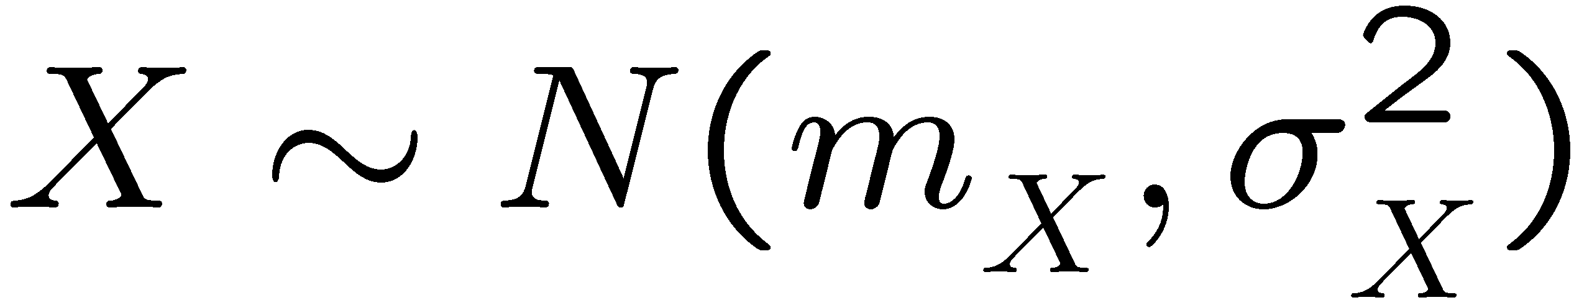

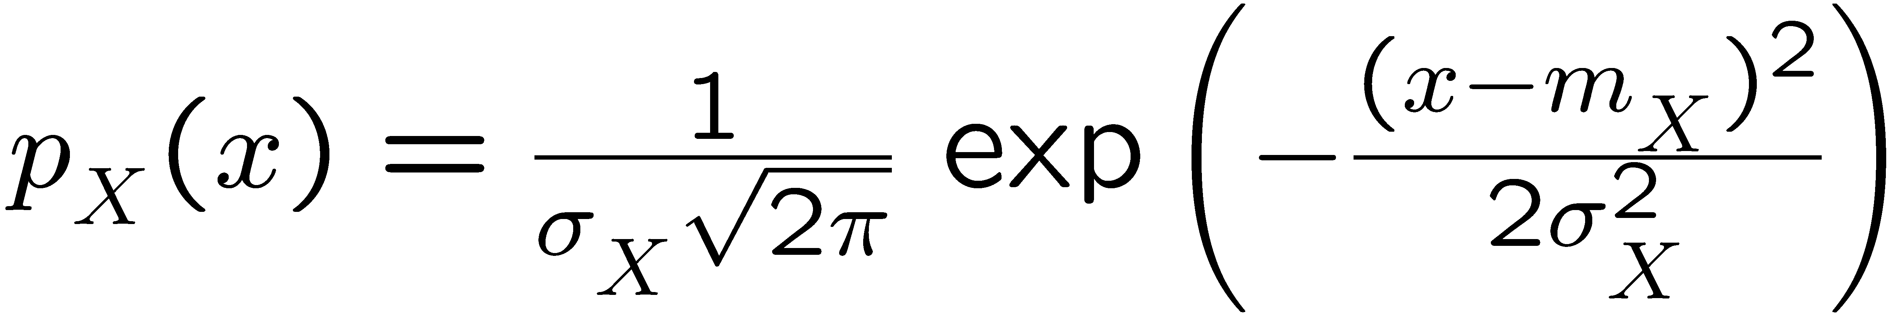
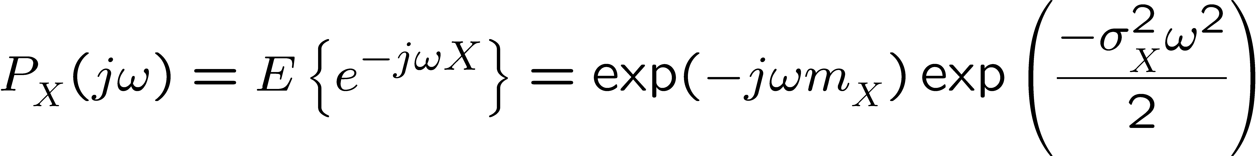
Moment generating functions of Normal PDFs
Let,
i.e.,
The moment generating functions of X is:

Slide 28
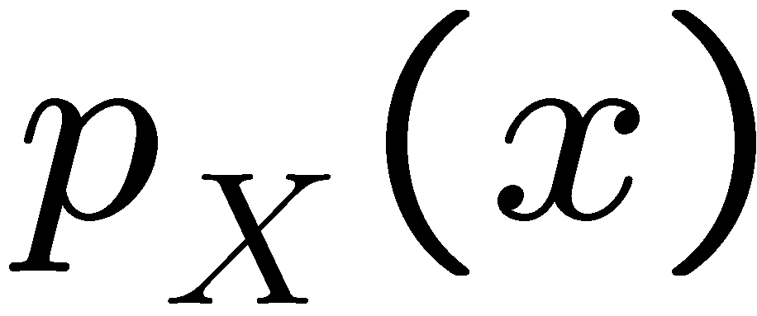
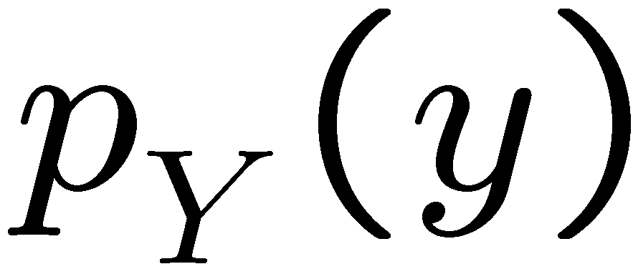

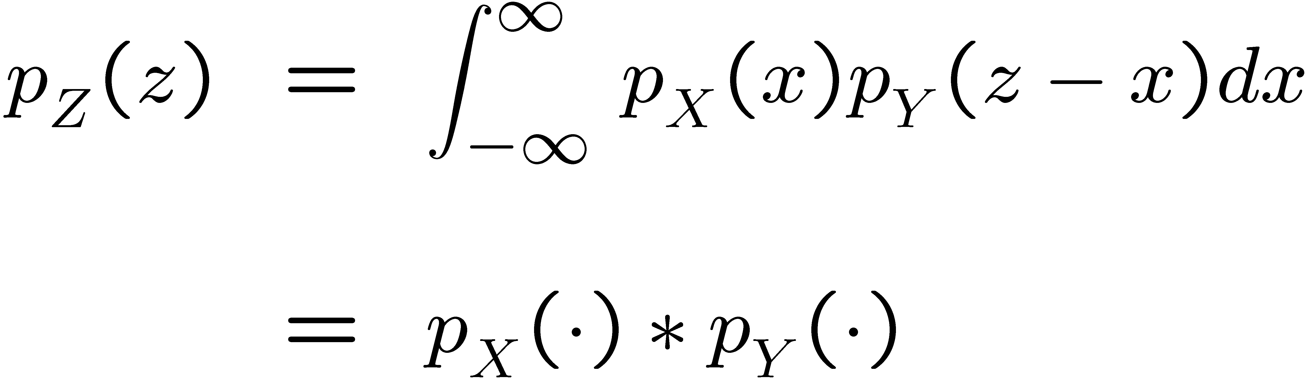
Sum of independent random variables
Let X and Y be two independent random variables with PDFs
Define
then
(convolution)

Slide 29
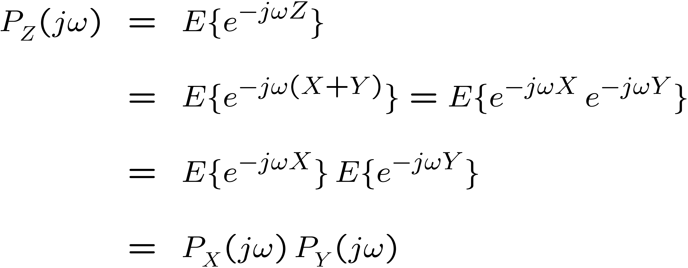
Proof
Assume X and Y are two independent random variables and define
Let us now calculate the moment generating function of Z:
(independence)

Slide 30
Proof
Since
Applying the inverse Fourier transform,

Slide 31
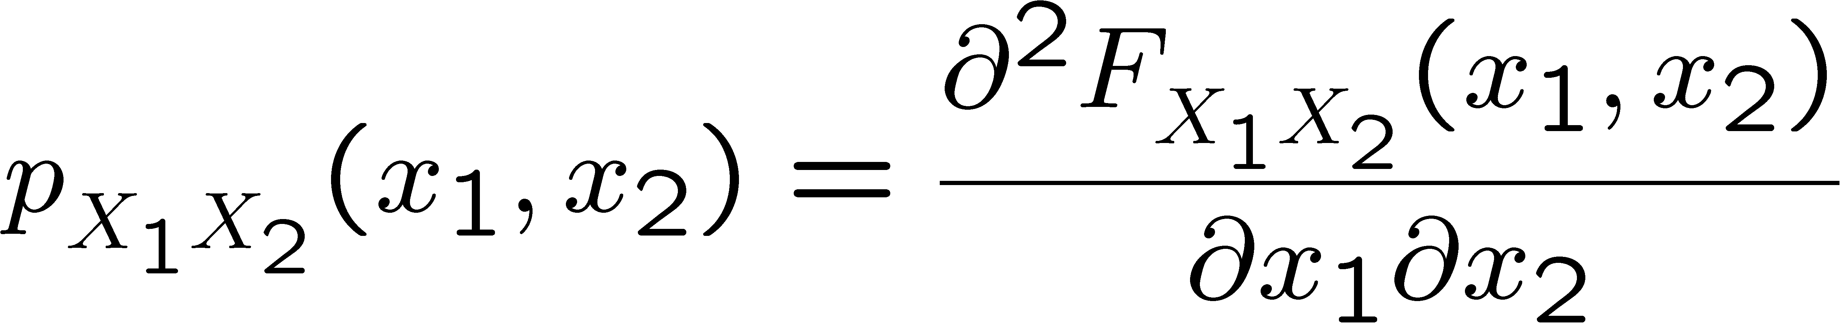
Random Vectors
Let X₁ and X₂ be continuous random variables.
Recall that:
Their joint CDF is given by
Their joint PDF is

Slide 32
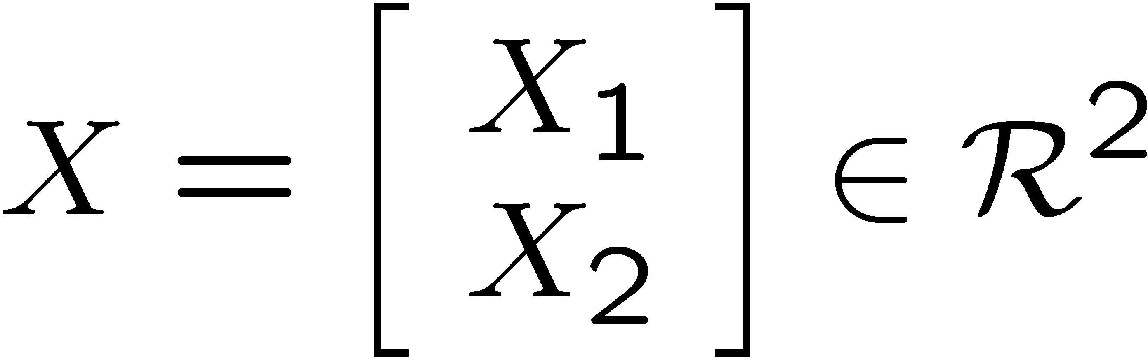
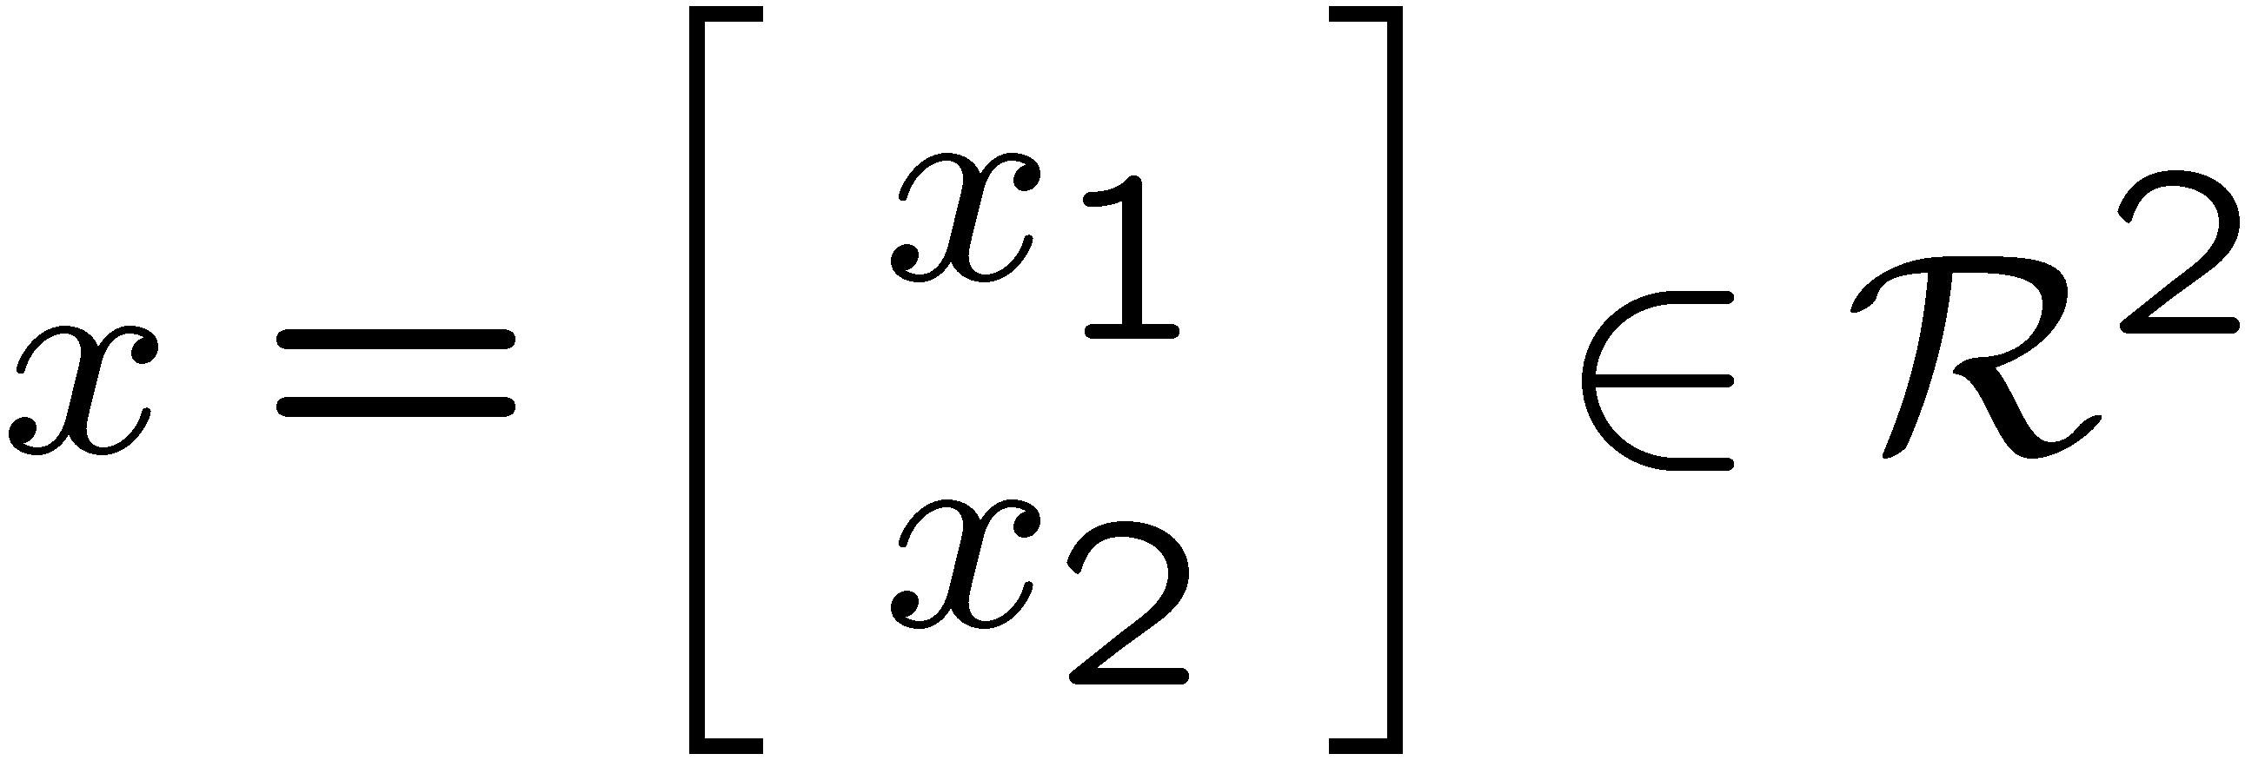
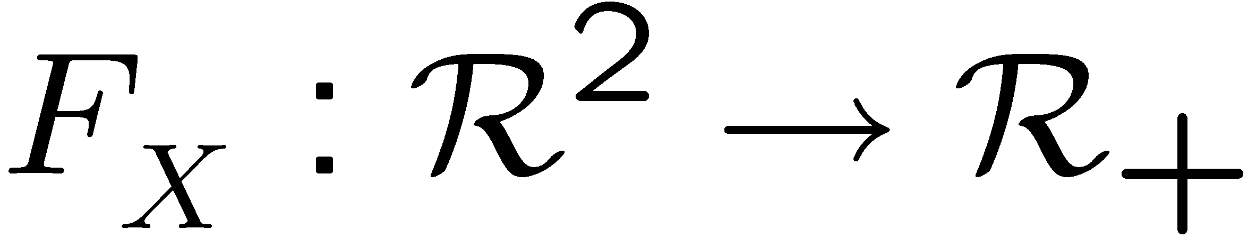
Random Vector
Define the random vector
(and the dummy vector)
with CDF

Slide 33
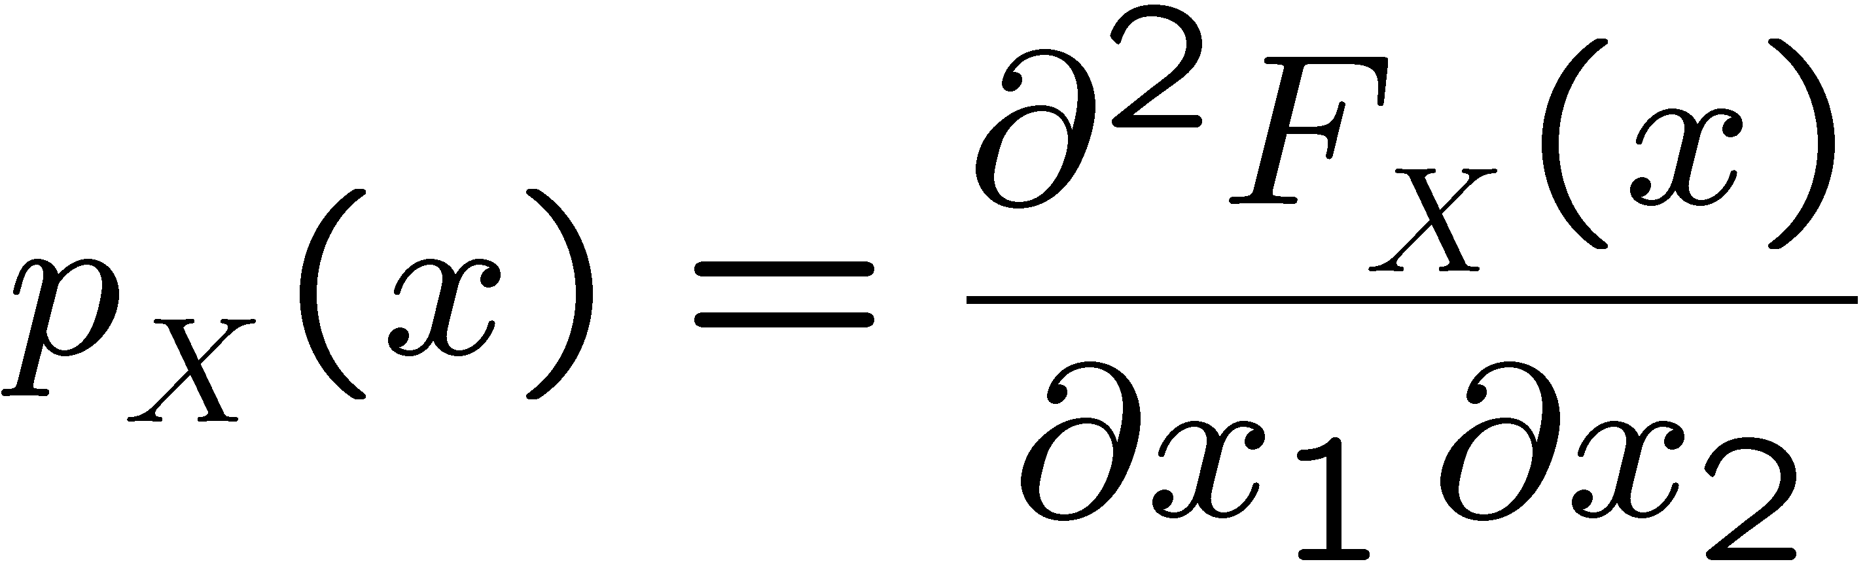
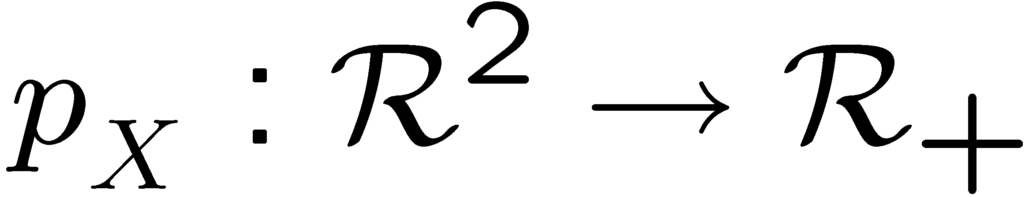
Random Vector
Define the random vector
(and the dummy vector)
with PDF

Slide 34
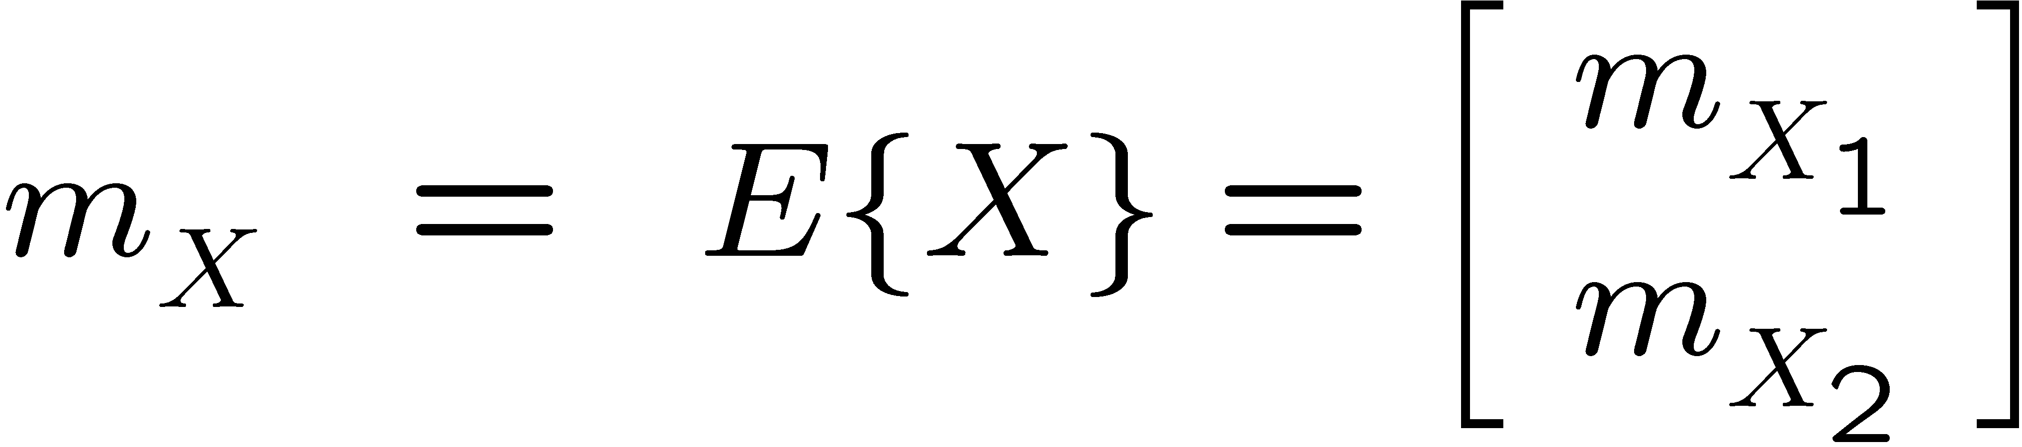
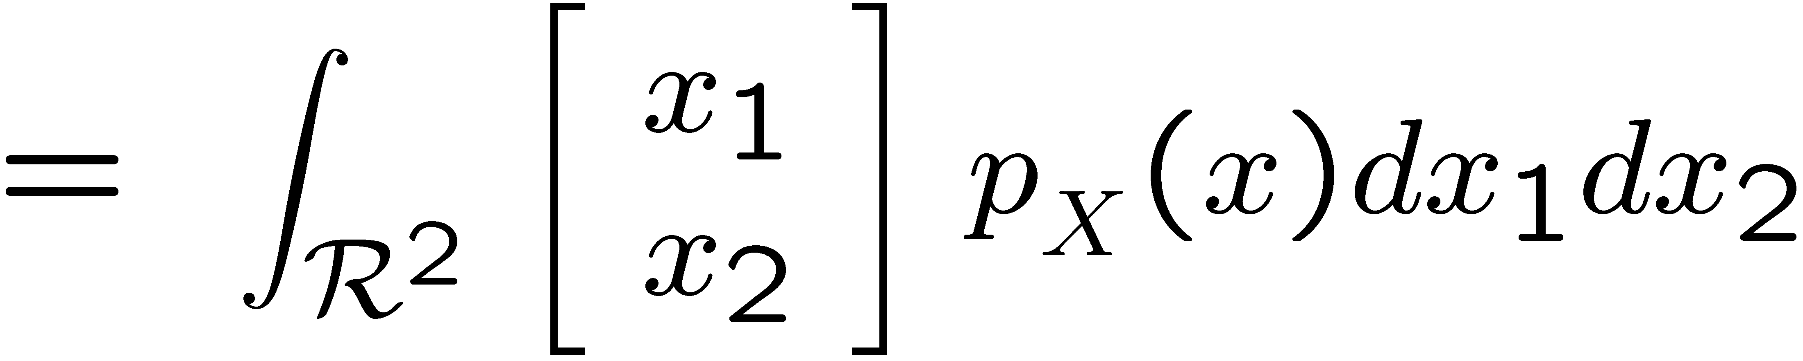
Random Vector
Define the random vector
Mean:

Slide 35
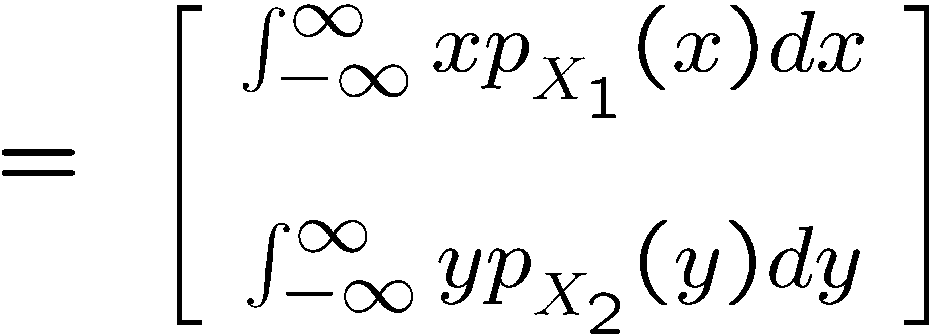
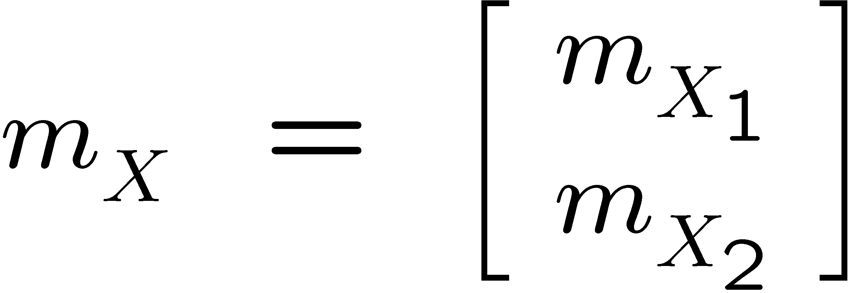


Random Vector
Define the random vector
Mean:
Marginal
PDFs

Slide 36


Correlation

Slide 37


Covariance

Slide 38





Covariance
Proof:
Define any deterministic vector
is a scalar random variable.

Slide 39






Random Vectors
X be a random n vector
Y be a random m vector
with PDF
with PDF

Slide 40



Cross-covariance
X be a random n vector
Y be a random m vector

Slide 41

Cauchy-Schwarz inequality
For any scalar random variables X and Y

Slide 42


Proof
Define the random vector
Thus,

Slide 43


Gaussian Random Variables (Review)
Let X be Gaussian with PDF
Frequently-used notation
X is normally distributed with
mean
and variance

Slide 44







Two independent Gaussians

Slide 45





Space-saving notation
dummy variables

Slide 46
Two independent Gaussians

Slide 47


Two independent Gaussians
Joint PDF of independent Gaussian X and Y

Slide 48

Two independent Gaussians
Joint PDF of independent Gaussian X and Y

Slide 49




Two independent Gaussians
Define the vector
(independent Gaussian X and Y)
Covariance

Slide 50





Two independent Gaussians
Joint PDF of independent Gaussian X and Y

Slide 51



Two independent Gaussians
Joint PDF of independent Gaussian X and Y

Slide 52



2-dimensional Gaussian random vector
X and Y
independent

Slide 53



n-dimensional Gaussian random vector
Joint PDF of a Gaussian vector
n: dimension of Z

Slide 54
Linear combination of Gaussians
If X is Gaussian and
where
A is a deterministic matrix
b is a deterministic vector
then Z is also Gaussian

Slide 55

Conditional PDF (Review)
Let X and Y have a joint PDF
The Conditional PDF of X given an outcome of Y = y₁ :

Slide 56


Conditional Expectation (Review)
Let X and Y have a joint PDF
Conditional Expectation of X given an outcome of Y = y₁ :

Slide 57


Motivation for Gaussians
When X and Y are Gaussians
The conditional probabilities
and conditional expectations
(for any outcome y )
can be calculated very easily!

Slide 58


Random Vectors
Define the Gaussian random n + m vector
X is Gaussian n vector
Y is a Gaussian m vector

Slide 59
Random Vectors
Y is a Gaussian m vector
X is Gaussian n vector
(n × n)
(m × m)
(n × m)

Slide 60


Conditional PDF for Gaussians
The conditional PDF of X given Y = y
also a Gaussian PDF

Slide 61

Conditional PDF for Gaussians
The conditional random vector X given and
outcome Y = y
is also normally distributed
(also a Gaussian random vector)

Slide 62

Conditional PDF for Gaussians
conditional expectation of X given Y = y
affine function of the outcome y

Slide 63

Conditional PDF for Gaussians
The conditional covariance of X given Y = y
independent of the outcome y !!

Slide 64


Conditional covariance of X given Y = y
max eigenvalues
min eigenvalue

Slide 65







Independent Gaussians
Let X and Y be jointly Gaussian random vectors.
X and Y are independent if and only if they are uncorrelated
Proof:
We already showed this this is true even if X and Y are not jointly Gaussian

Slide 66
Proof of conditional PDF for Gaussians
Idea of proof
Some details regarding Schur complements
A lot of algebra…

Slide 67



Schur complement
Given
Schur complement of B:
Then

Slide 68



Schur complement
Given
If Schur complement of B
is nonsingular
Then

Slide 69






Proof
Define
Given
Then
Results follow by computing inverses and determinants of matrices Q and R

Slide 70






details

Slide 71




Conditional covariance
Given
The Schur complement of

Slide 72



Schur complement of
Given
Then

Slide 73


Schur complement of
Given
and

Slide 74

Theorem
Given
Then
with

Slide 75





Proof
Random vector
dummy variables

Slide 76



Proof: use Schur complement
Now compute:
Using:

Slide 77

Proof
Now compute:

Slide 78




Proof: compute the conditional PDF
where:
dimension of Y

Slide 79


Proof: compute the conditional PDF
where:
dimension of X + dimension of Y

Slide 80




Proof

Slide 81


Proof

Slide 82


Proof
use Schur determinant result:

Slide 83

Proof
Now use:

Slide 84




Proof
Now use:

Slide 85
Proof
Therefore,

Slide 86
Proof
Therefore,
with
This result is important and constitutes the basis for the Kalman Filter!

Slide 87
Supplemental Material (You are not responsible for this…)
Laplace and Fourier transform of Gaussian PDF
Transformation of random variables

Slide 88





Laplace transform of normal PDF
where, after “completing the squares”,

Slide 89


Laplace transform of normal PDF
substituting,
= 1
(area under a PDF = 1)
Fourier transform:

Slide 90



Transformation of random variables
Given a real valued function f of random variable X
Assume that Y is also a random variable.
Also assume that exists. Then,

Slide 91




Transformation of random variables
Let and

